Slide 1

Shopping Behaviour Analysis
Barbara Klimova, Aleem Shaikh
Brain Station - Data Analytics Certificate
22.10.2025
Notes:
*Aleem

Slide 2
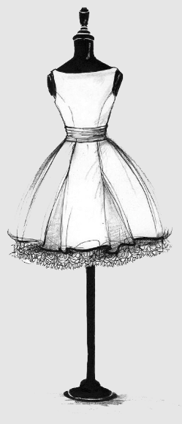

Agenda
Problem Statement
Hypothesis Formulation
Data Cleansing & Organization
Analysis of Findings
Visualization of the Storyline
Summary & Recommended Solutions
Dress
to
Impress
Basic to premium clothing & accessories
Notes:
*Aleem to add background to presentation + image here

Slide 3
The Problem Statement
Target Audience
The Leadership Team at Dress to Impress has an interest to increase revenue and scale the business into further product lines.
Target Focus
The focus is on on evaluating seasonality and consumer trends by demographic profile based on age, gender and shopping behaviour patterns.
Target Purpose
The Head of Sales would like to…
Understand their consumer demographic trends to establish a sales strategy for expansion of product lines
Set promotions by seasonal trends
The Head of OPS would like to…
Set Free Shipping on orders over certain threshold
Determine whether AfterPay is a sought after payment method
The Head of MKT would like to…
Send out targeted promotional EDMs to subscribers to alert on seasonal product line expansions
Send out targeted promotional EDMs by shopping behavior per territory
Main goal for the LT is to…
Set a marketing promotional calendar strategy for the 2026 Calendar year
Notes:
*Barbara: The Target Audience is the Leadership Team at Dress to Impress who has an interest to increase revenue and scale the business into further product lines.
The target focus is on on evaluating seasonality and consumer trends by demographic profile based on age, gender and shopping behaviour patterns.
And the target purpose of our project is to provide recommendation to each of the leadership team respectively. To the Head of Sales we will support the establishment of a sales strategy for expansion of product lines and to set promotions by seasonal trends.
We will also assist the Head of Ops on decision making around free shipping over a certain threshold and whether AfterPay is a sought after payment method.
We will assist the Head of MKT on determining which seasonal product line expansions to consider as well as evaluating shopping behavior by territory.
Last but not lease we will assist the Leadership team on creating a marketing promotional calendar strategy for 2026.

Slide 4
Hypothesis
Customer Behaviour Hypotheses
Older customers tend to spend more per purchase than younger customers.
Subscribed customers have higher purchase frequency and total purchase count than unsubscribed ones.
The subscribed customers would have the highest average units per order from the seasonal items based on climate.
Product category preferences vary significantly by gender; females most likely purchase more accessories and footwear.
Product Performance Hypotheses
Products from “summer” or “spring” season show spikes in number of purchases midway through the season whilst “winter” and “fall” at the beginning of the season.
Higher-rated products are purchased more frequently and generate higher revenue.
Purchase Dynamics Hypotheses
The average customer would spend more on their purchase if they are offered free shipping.
Younger customers prefer digital wallets, while older customers lean toward credit cards.
Territory Trend Hypotheses
Customers in the Northeast and Midwest are purchasing higher amount of winter and fall clothing than customers in the South and West; purchasing higher amount of summer and spring clothing.
Notes:
*Aleem to share first four & Barbara to share last four ; animation of just one sentence at a time

Slide 5
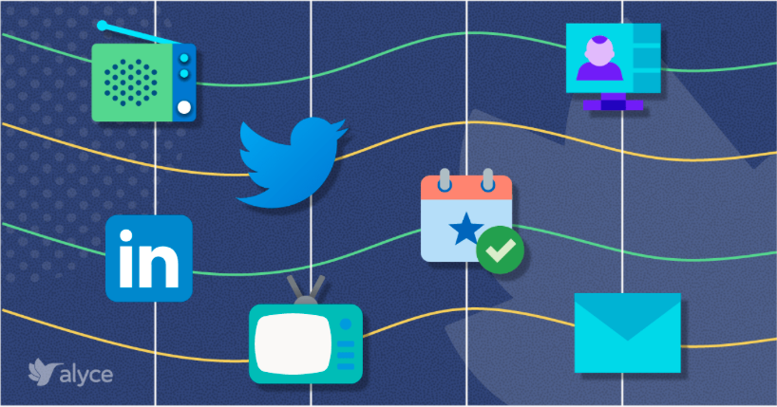
Data and Tools Used
Where did you find the dataset?
Our dataset was found on Kaggle.com
Did you have to join multiple datasets in order to create the ideal dataset?
No, however our dataset had to be cleaned, and variables e.g. purchase date and purchase id added so that we could build a relational database
Which tools did you use to undertake the processing and statistical analysis?
Microsoft Excel
SQL
Tableau
What other data would you have liked to have in an ideal scenario?
•Lead source of acquisition channel to assist the Marketing team on strategy of most profitable channels and expansion into further channels
•Territories instead of states and Sales reps assigned to those territories
Notes:
*Aleem; when speaking to territories you can share if you want that if we had territories and sales rep allocation we could suggest potential strategies for setting sales targets

Slide 6
Data Processing
Data cleansing process:
Inspected column types, nulls, and row counts across tables
Remove duplicates using DISTINCT and ROW_NUMBER() on product attributes
Validated joins between purchases, products, and customers
Customers and Products are connected through Purchases.
Standardized inconsistent values and normalized categories
Parsed purchase_date into MONTH() and YEAR() for seasonal analysis
Determining Outliers:
Flagged outliers in purchase amount, rating, and purchase count
Set business rules to derive persona based on Median, STDEV to create Upper and Lower Limits (Example: Upper limit: Median + 0.5* STDEV, Lower Limits: Median - 0.5*STDEV)
Preserved valid outliers unless clearly erroneous or duplicated
Set Assumptions:
Assumption 1:
The dataset is suggesting that each customer only made one order, therefore limitation of following customer retention journey
Assumption 2:
The average purchase per customer of one type of item is 25 units, which is quite high. Data suggests the customers are purchasing the units to resell at their own store. Dress to Impress -> wholesaler
Assumption 3:
Our dataset from Kaggle did not include a purchase date therefore it is fictional to determine seasonality and could be skewing our data
Notes:
*Aleem

Slide 7
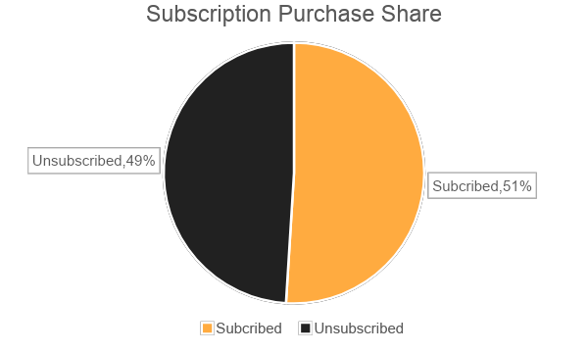
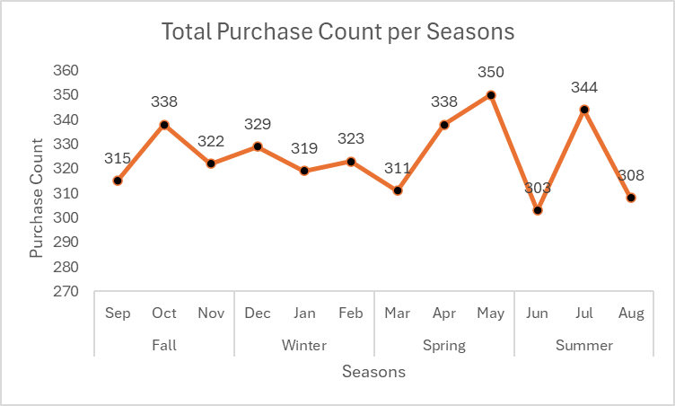
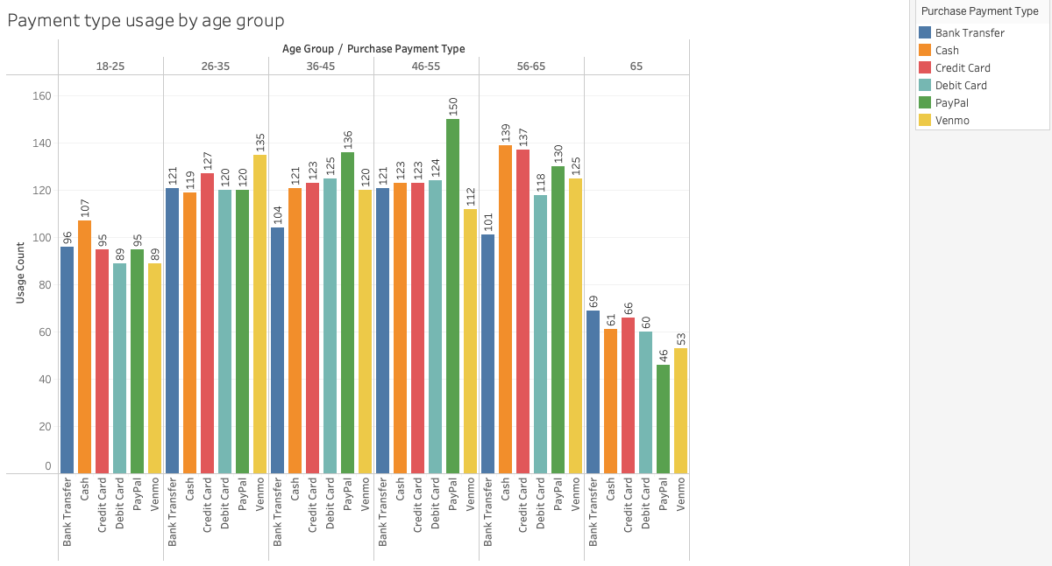
Data Processing
Were there any surprising insights from your data processing/exploration?
The gap between average purchase count between subscribed and unsubscribed customers was quite narrow only 2% higher for subscribed customers a opposed to unsubscribed
Males seem to be purchasing twice as much in every category compared to females
Highest rated products have not necessarily been purchased the most frequently and didn’t generate higher revenue than the lower rated products.
The youngest customer actually prefer cash and the customers that are 65+ prefer payment by credit card
Notes:
*Barbara -The gap between average purchase count between subscribed and unsubscribed customers was quite narrow only 2% higher for subscribed customers a opposed to unsubscribed
Males seem to be purchasing twice as much in every category compared to females
Highest rated products have not necessarily been purchased the most frequently and didn’t generate higher revenue than the lower rated products.
The youngest customer actually prefer cash and the customers thay are 65+ prefer payment by credit card
* I know you might not be able to see the graphs, however we are just highlighting them here and we will be displaying them individually on the next slides.

Slide 8
Statistical Analysis
Marketing trends analysis
Consumer Trends by Age group
Consumer Trends by Gender
Consumer Trends by Ratings
Operations trends analysis
Shipping Preferences
Payment type usage by Age group
Sales trends analysis
Subscribers purchasing trends by season
Sales spikes based on seasonality
Seasonal Trends by Territory
Notes:
*Barbara: We first analyzed the consumer demographic trends to establish our target market for expanding the product lines. Furthermore, we looked at purchasing patterns by ratings to establish whether consumer behavior is affected by rating of product.
We also analyzed shipping preferences to provide the Head of Operations guidance on allowing free shipping and we will be sharing the payment type trend analysis by age to establish whether we would like to offer afterpay as a payment solution; based on credit card use.
We then analyzed the subscriber seasonal patterns to establish a rewards program for the subscribers customers.
We also evaluated the seasonal spikes based on the trends in each season to establish a strategy for setting a marketing promotional calendar.

Slide 9
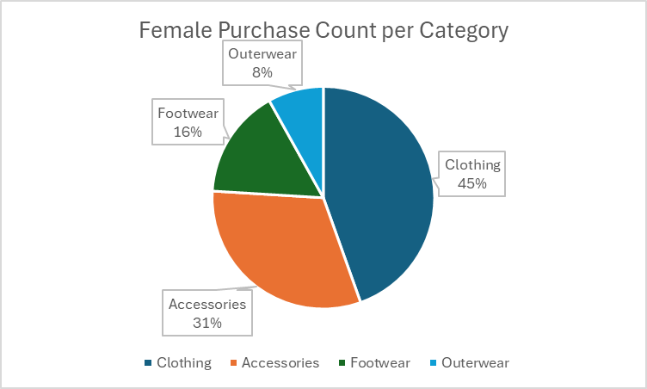

Do product preferences vary by gender?
It seems that either our product portfolio has much more range and/or is much more attractive for males as males seem to be purchasing twice as much in every category. Our advice to the Marketing team is to boost the targeting of the female audience and expand the product ranges for females to attract more sales from this target customer profile.
Customer_gender | Product_category | Purchase_count
Female | Clothing | 556
Female | Accessories | 392
Female | Footwear | 199
Female | Outerwear | 101
Male | Clothing | 1181
Male | Accessories | 848
Male | Footwear | 400
Male | Outerwear | 223
Notes:
*Aleem

Slide 10
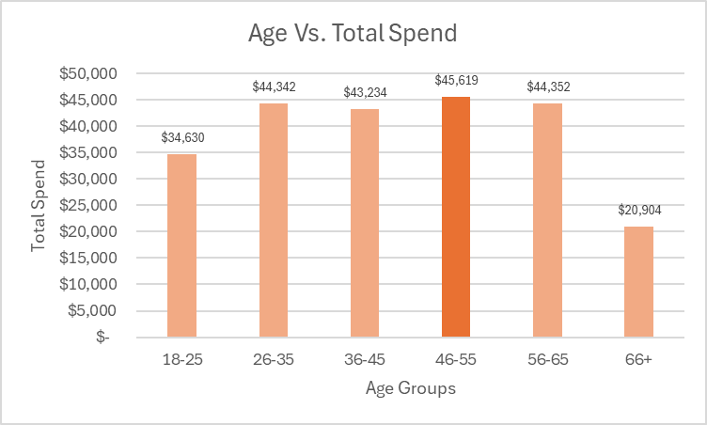
Older customers spend more per purchase than younger customers
Customers aged 46-55 have the most disposable income as they have spent the most in total purchases
Age_Group | Total_purchase_amount
18-25 | $ 34,630.00
26-35 | $ 44,342.00
36-45 | $ 43,234.00
46-55 | $ 45,619.00
56-65 | $ 44,352.00
66+ | $ 20,904.00
Notes:
*Aleem

Slide 11
Customer Persona
Young Budget Shoppers: Age < 30, Spend < Low Spend, Purchase Count > High Frequency
Loyal High Spenders: Age between 36–60, Spend > High Spend, Subscribed
Occasional Deal Seekers: Purchase Count < Low Frequency, Spend < Low, Unsubscribed
Personas | Customers | Revenue | ARPU
Young Budget Shoppers | 168 | $ 128,493 | $ 764.84
Loyal High Spenders | 230 | $ 569,076 | $ 2,474.24
Occasional Deal Seekers | 858 | $ 413,151 | $ 481.53
Notes:
*Aleem

Slide 12
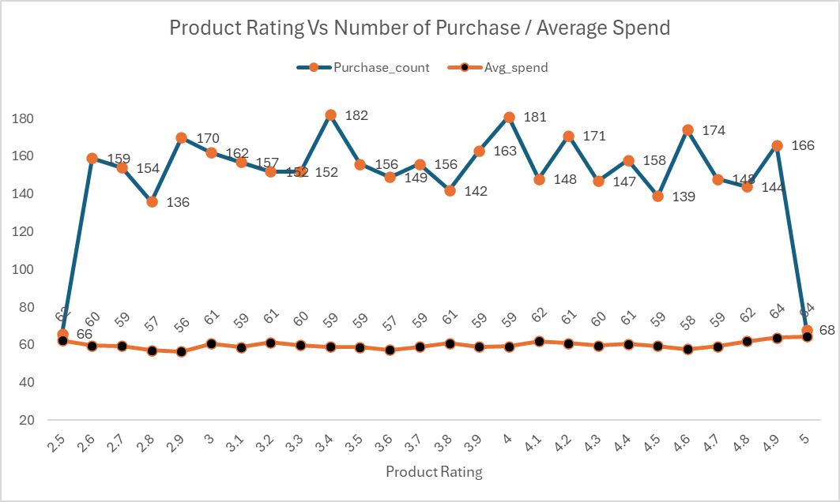
Do higher-rated products sell more?
Our Hypothesis proved to be wrong as the highest rated products have not necessarily been purchased the most frequently and didn’t generate higher revenue than the lower rated products. This trend is showing that when people want to buy in bulk they might not care so much about the higher rating of the product, rather looking at the price of the individual product.
The average highest sale amount was spent on the highest rated product, which comes to show that on average customers are willing to spend more on a higher rated product at less volume.
Notes:
*Aleem: change title and add summary of findings in the speaker notes
-> incentivising for buying in bulk via subscribers rewards scheme

Slide 13
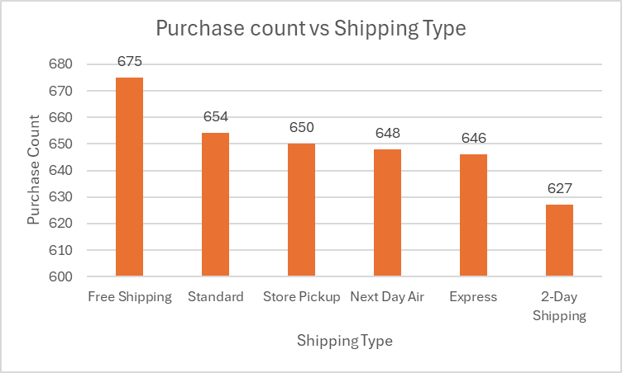
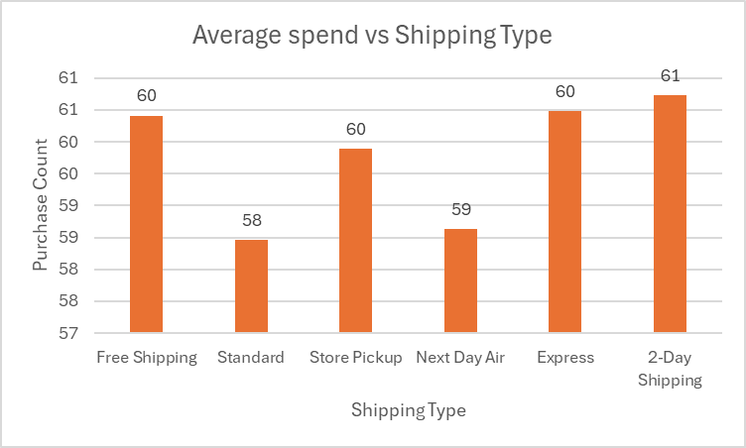
Does shipping type affect the number of purchases?
The purchase count is highest on free shipping and the average customer is willing to spend more when offered free shipping.
Purchase_shipping_type | Purchase_count | Avg_spend
Free Shipping | 675 | 60
Standard | 654 | 58
Store Pickup | 650 | 60
Next Day Air | 648 | 59
Express | 646 | 60
2-Day Shipping | 627 | 61
Notes:
*Aleem

Slide 14
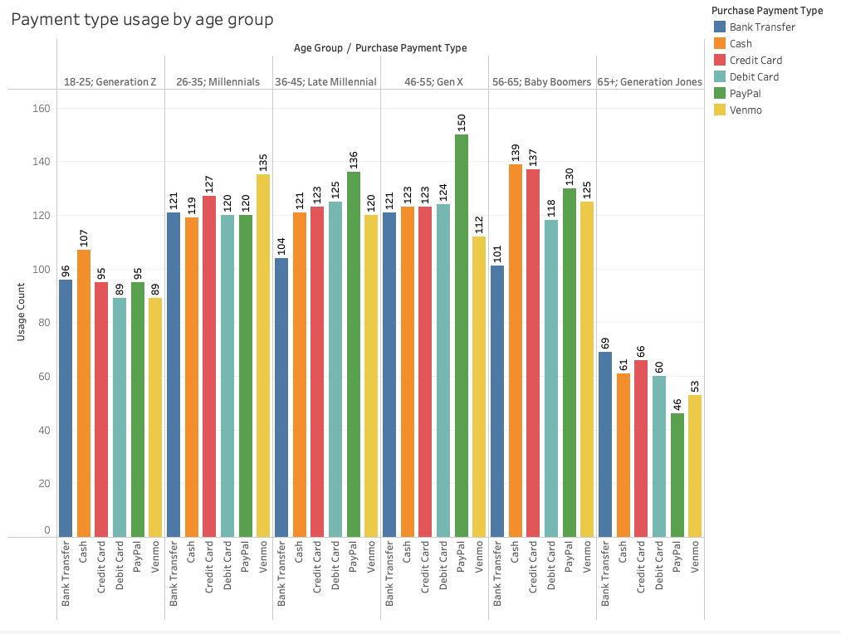
Notes:
*Barbara: The Gen Z's actually prefer cash, perhaps as they are not yet so used to using a bank account. Early Millennials prefer Venmo; fast & easy and Credit Card due to most of their disposable income going towards the high cost of living. Late Millennials and Gen X prefer PayPal and Debit Cards as they don’t want to aggregate debt later in their life.
Whereas the Baby Boomers once again prefer good old cash, however it is surprising that they also prefer credit card as they enter retirement. Lastly, the Generation Jones prefers to pay by old school bank transfer or credit card as well, nevertheless we can see that this age group only made half the orders of what each other group made.

Slide 15
Do subscribed customers purchase more frequently?
Average purchase count stands at 26.08 for subscribed customers vs. 25.08 for unsubscribed.
Customer_subscription | Avg_purchase_count
Subscribed | 26.0845
Unsubscribed | 25.0804
Notes:
*Aleem - request from Barbara; if this graph is updated please also update in slide 7 for data processing; thanks

Slide 16
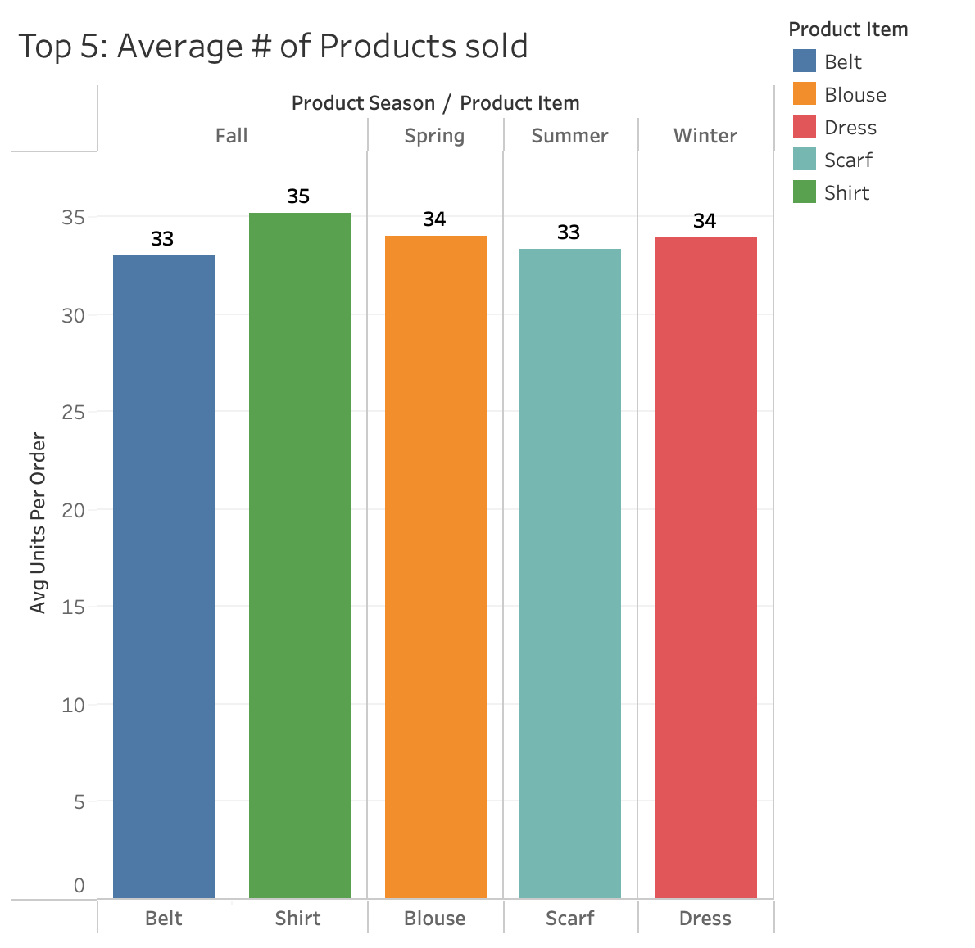
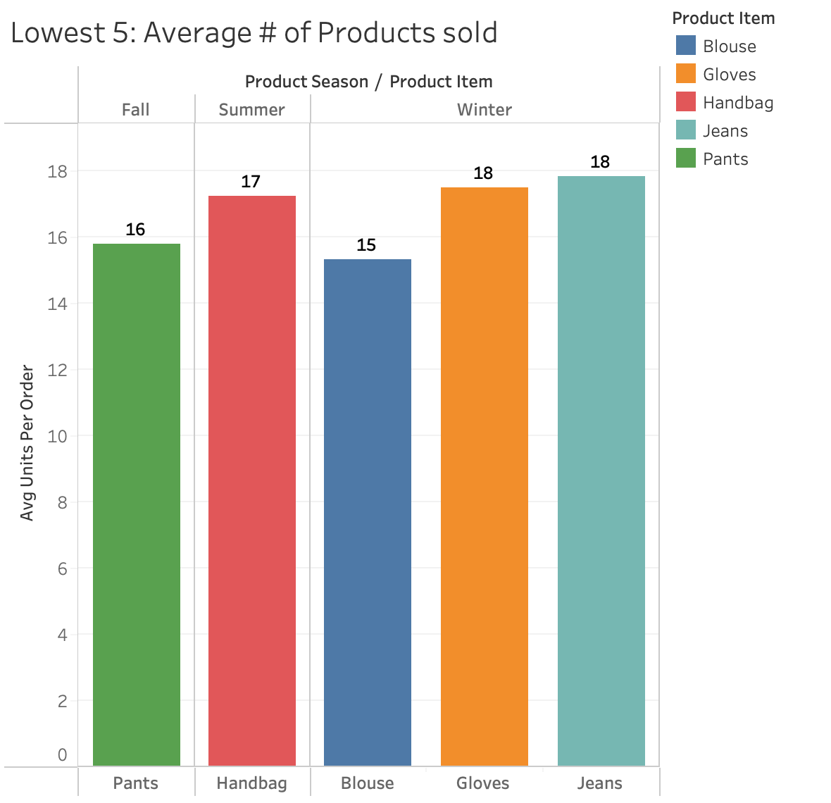
Subscriber seasonal purchasing patterns
Notes:
*Barbara: It was surprising for us to see that among the top 5 average # of products sold the company had sold 34 units of dresses per subscriber in winter amd 33 units of scarves in the summer. Makes us wonder if there was a special promo going on to offer dresses from the last season on high discount and if the scarves were just summer scarves or a promo was run for the winter scarves from last season as well. If margins allow and if we are overstocking, we can repeat a similar promo this year. Other than that we would recommend to focus on following the trends in this product line range for possible revamp of products and then spotlighting the following products; Belts & Shirts in Fall, Blouses and in Spring and Pants and Scarves in Winter and dresses in Summer.
As for the lowest average products sold, which are Pants in Fall, Handbags in summer and Blouses, Gloves and Jeans in winter, we would advise the teams to also revisit the product line quality and range and try to spotlight them via EDMs to boost sales.

Slide 17
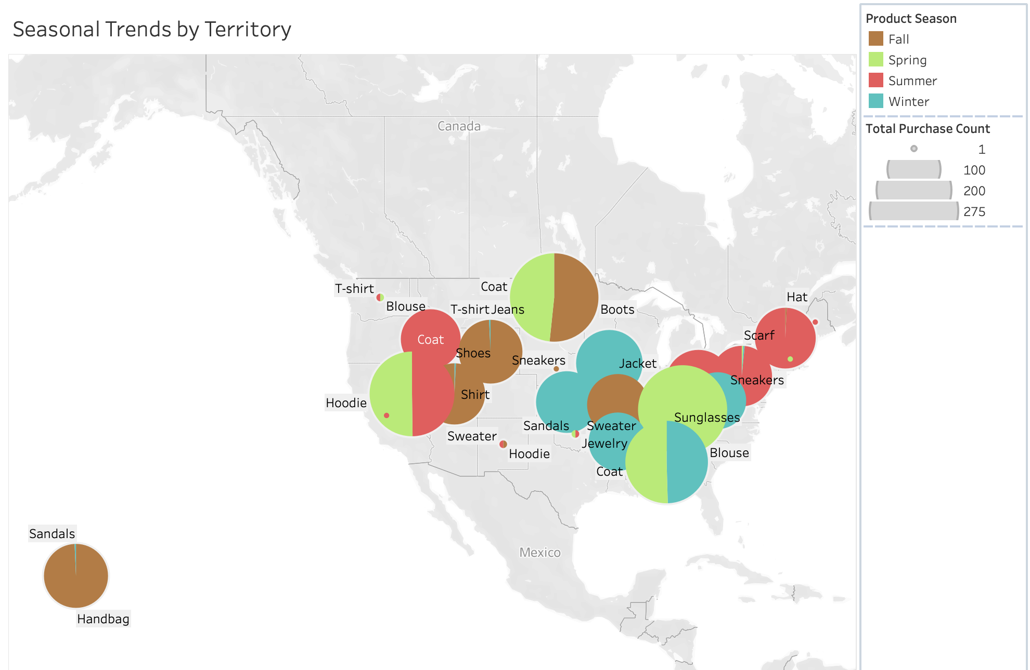
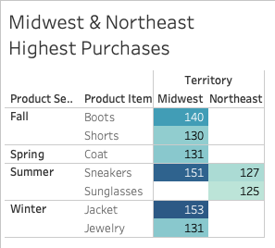
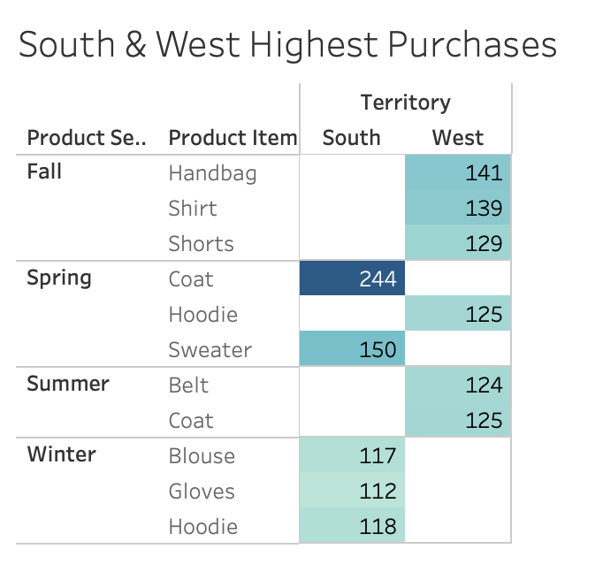
Notes:
Barbara: As per the above we have concluded that Northeast and Midwest customers were purchasing high amounts of products in winter and fall; highest purchases were in boots and jackets, whilst in spring and summer they purchased highest amount of coats, sneakers and sunglasses, which is a moderate type of purchase based on their climate.
Whereas customers from the South and West territory had the highest number of purchases in Spring, Fall and Summer purchasing accessories, shorts, shirts, hoodies and sweaters as well as summer coats. Whilst in winters their highest purchases were of blouses, hoodies and gloves which again shows moderate purchasing patterns as per their climate.

Slide 18
Establishing trends in seasonal spikes
Seasons | Months | Purchase Count
Fall | Sep | 315
 | Oct | 338
 | Nov | 322
Winter | Dec | 329
 | Jan | 319
 | Feb | 323
Spring | Mar | 311
 | Apr | 338
 | May | 350
Summer | Jun | 303
 | Jul | 344
 | Aug | 308
In Fall and Summer purchases were the highest throughout the season suggesting that most customers shop more midway through the season after potential discounts have been offered and trends have been set.
Whereas in Spring the highest number of purchases occurred in the last month, suggestion to Marketing for promoting spring trends before the season starts to spike up the sales in the earlier month of the season.
Lastly, winter sales were the highest in December suggesting success of strong impact from early winter campaigns and promotions.
Notes:
*Aleem. This query was run to set promotional strategies : when is the right time to send out the EDM? Perhaps Change to trend line and update table and chart by month

Slide 19
Summary Conclusions
Was our Target Purpose met?
The Head of Sales would like to…
Target 1: Understand their consumer demographic trends to establish a sales strategy for expansion of product lines
Recommendation 1: Focus product line expansion on the 36–55 age group, who show the highest total spend, and diversify offerings for female customers, who currently purchase less across all categories. Tailor product development to align with these underserved yet high-potential segments.
Target 2: Set promotions by seasonal trends
Recommendation 2: Start with promotions one month prior to the season so that we can increase the early season sales.
The Head of OPS would like to…
Target 3: Set Free Shipping on orders over certain threshold
Recommendation 3: As a wholesaler with average sales of 26 units per item we suggest free shipping on orders with MOQ of 10 per item.
Target 4: Determine whether AfterPay is a sought after payment method
Recommendation 4: In order to motivate Early Millennials, Baby Boomers & The Generation Jones and support their preferred payment usage by increasing payment options on credit; we would recommend to offer AfterPay; buy more pay later.
The Head of MKT would like to…
Target 5: Send out targeted promotional EDMs to subscribers to alert on seasonal product line expansions
Recommendation 5: EDM to all customers notifying of the new rewards scheme providing tiered discounts for subscribers who make the highest amount of purchases
Target 6: Send out targeted promotional EDMs by shopping behavior per territory
Recommendation 6: EDM by geographic location to set trends via blogs etc. to set product incentives as per territory climate
The LT would like to…
Target 7: Set a marketing promotional calendar strategy for the 2026 Calendar year
Recommendation 7: Trends in seasonal spikes to set subscriber promotional calendar per each territory
Notes:
*Aleem: Sales, Ops & Barbara: MKT, Both
Barbara: Recommendation 5: Send out an EDM notifying all customers about the rewards program for subscribers who make the highest amount of purchases to obtain reward points for each time they buy 10 units or more of each item, they will receive tiered discounts.The rewards program will not only motivate the unsubscribed customers to subscribe but also for the customers to buy more as on average currently 26 units are purchased by a subscribed customer and 25 by unsubscribed. If they push it up to 30 this will increase sales and provide customers with an incentive to receive a discount.Furthermore ensure that only subscribers have access to the newest product line range for more predictable, recurring revenue and more personalized marketing to increase customer lifetime value.
Recommendation 6: Send out an EDM EDM by geographic location to set trends via blogs and promotional incentives on items per each territory’s climate.
Recommendation 7: Based on findings from the trends in seasonal spikes set a promotional calendar per each territory for subscribed customers

Slide 20
Key Learnings
When running the queries and realising that some of the results don’t make much sense, ensure that the data has been inputted in the dataset; reporting in real life accurately.
Solution -> Cross check the data with the department manager/SMEs.
Notes:
Barbara: When running the queries and realising that some of the results don’t make much sense (e.g. purchasing trends of items based on climate or payment method usage based on age group). Ensure that the data has been inputted in the dataset; reporting in real life accurately as sometimes data might not be accurate which can skew our statistical analysis.

Slide 21
Thank You

Slide 22
References
Link to dataset from Kaggle : https://www.kaggle.com/datasets/zubairamuti/shopping-behaviours-dataset
Shopping Behavior updated: attached
Final queries file : attached
Individual table csvs: attached
Persona Statistical Analysis: attached

